Slide 1
Azure Active Directory Identity is the new control plane
Rory Braybrook
Microsoft Identity Architect
@rbrayb
#GlobalAzure

Slide 2


Digital Transformation is an economic imperative

Slide 3
Digital Transformation
Key computing trends
+
+
+
Cloud
Mobile
IoT
Digital
Many applications and services
Many devices and applications
Billions of devices and things
Many corporate & personal personas
Multiple identities
+
Multiple identities
+
Multiple identities
+
Multiple identities

Slide 4


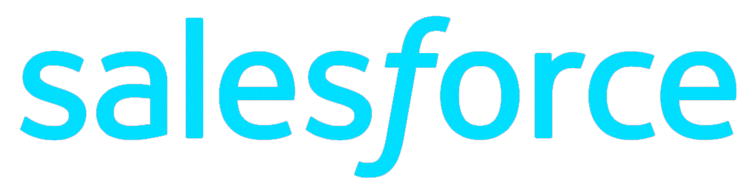


CLOUD APPS AND SAAS SERVICES
On-premises

Slide 5






MOBILE AND PERSONAL DEVICES
On-premises

Slide 6
ORGANIZATION & SOCIAL IDENTITIES
On-premises

Slide 7

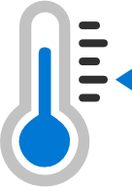
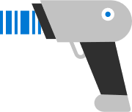
INTERNET OF THINGS (IOT) DEVICES
On-premises
Organization and social identities

Slide 8




On-premises

Slide 9


Identity is the new control plane
Partners & Customers
Cloud Apps
Employees
Identity
On-premises & web apps
Devices

Slide 10
Identity is the new control plane
Azure Active Directory

Slide 11






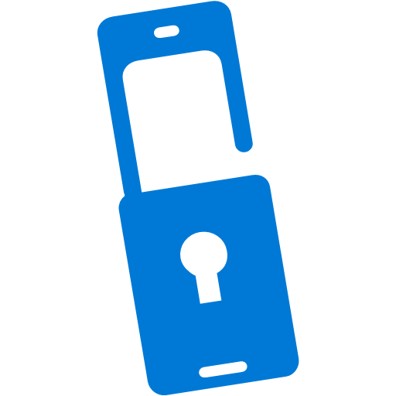





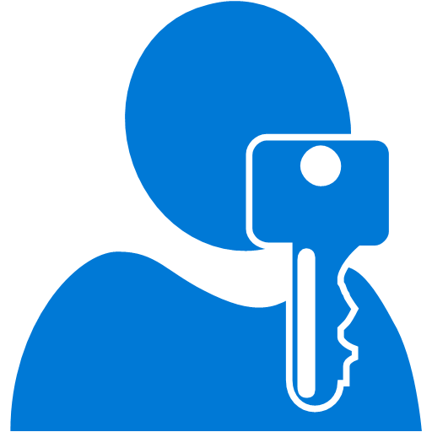






Azure Active Directory
Azure AD Connect
B2B collaboration
Provisioning-Deprovisioning
Conditional Access
SSO to SaaS
Self-Service capabilities
Connect Health
Multi-Factor Authentication
Addition of custom cloud apps
Access Panel/MyApps
Dynamic Groups
Identity Protection
Remote Access to on-premises apps
Azure AD B2C
Group-Based Licensing
Privileged Identity Management
I want to provide my employees secure and easy access to every application from any location and any device
I need my customers, partners, and users to access the apps they need from everywhere and collaborate seamlessly
I want to quickly deploy applications to devices, do more with less and automate Join/Move/Leave processes
[dev use case]
I want to protect access to my resources from advanced threats
I need to comply with industry regulation and national data protection laws
Microsoft Authenticator - Password-less Access
Azure AD Join
MDM-auto enrollment /
Enterprise State Roaming
Security Reporting
Azure AD DS
Office 365 App Launcher
HR App Integration
Access Reviews

Slide 12
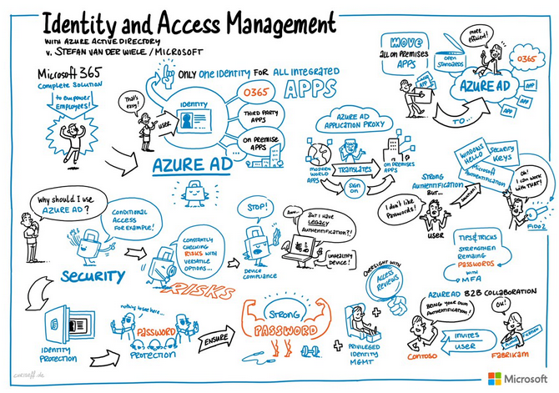

Slide 13
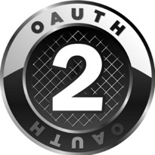



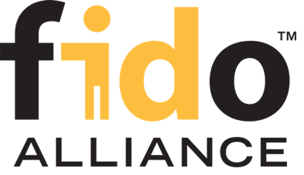

Open Standards
 |  |  | WS-Fed
WebAuthn

Slide 14

Azure AD
By the numbers

Slide 15
Windows Azure momentum
54%
Fortune 500 companies signed up for Microsoft Azure
>1000
New customers a day
2X
Compute and storage every six months
400K
SQL Databases on Microsoft Azure
170K
Web sites on Microsoft Azure
430B
Authentications via Microsoft Azure Active Directory

Slide 16
Azure AD by the Numbers
86%
of Fortune 500 companies on Microsoft Cloud (Azure, O365, CRM Online and PowerBI)
Azure AD manages identity data for
>5 M organizations
More than
500 M objects hosted on Azure Active Directory
1 Trillion
Azure AD authentications since the release of the service
50 M Office 365 users active every month
>1 Billion authentications every day on Azure AD
Every Office 365 and Microsoft Azure customer uses Azure Active directory

Slide 17
Azure Active Directory in the Marketplace
Every Office 365 and Microsoft Azure customer uses Azure Active Directory
17.5 M
1.1B
732 K
organizations
identities
3rd party apps
in Azure AD
90 K
8 B
90 %
paid Azure AD / EMS customers
daily Azure AD authentications
of Fortune 500 companies
Dec 2018

Slide 18















Azure Active Directory 3rd party applications
ServiceNow
Google Apps
Workday
SuccessFactors
Schoology
Concur
Salesforce
870K
Workplace by Facebook
31M
Myday
Canvas
active 3rd party apps integrated with Azure Active Directory
Cornerstone OnDemand
monthly active users of 3rd party apps
Blackboard Learn
Clever
Box
Firefly
February 2018
# monthly active users

Slide 19





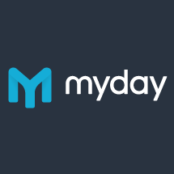









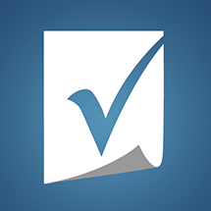



















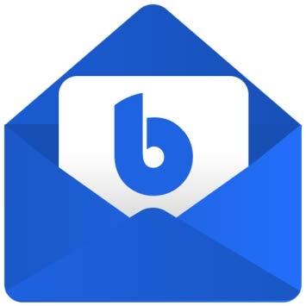

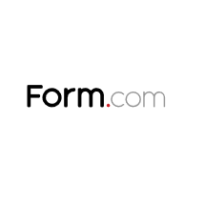

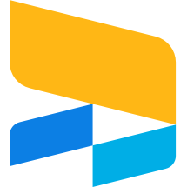

New to the Azure App Marketplace
Federated Connectors
Provisioning Connectors
3rd party native Azure AD apps
Sauce Labs – Mobile and Web testing | SkyHigh Networks | Jamf Pro
Skillport | Palo Alto Networks | Fidelity NetBenefits
OneTrust Privacy Management Software | Adobe Creative Cloud | Adobe Experience Manager
Apptio | Carlson Wagonlit Travel | DigiCert
SAP Cloud Platform Identity Authentication | Form.com | OrgChart Now
Cisco WebEx | Samanage
GitHub | LucidChart
BlueJeans | Zendesk
Tableau Online | ThousandEyes
Pingboard | Slack
Myday | Canvas | Calendly | Templafy
Doodle AG | Smartsheet | Nine for Office365 | K2 for Office365
Exclaimer Cloud | Firefly | Insights | Cronofy
Flipgrid | Edmodo | Boomerang | Bluemail
…and more added each month

Slide 20

Azure AD
World-class security

Slide 21
Hybrid identity
Notes:
EMS Overview
© 2014 Microsoft Corporation. All rights reserved. Microsoft, Windows, Surface and other product names are or may be registered trademarks and/or trademarks in the U.S. and/or other countries. The information herein is for informational purposes only and represents the current view of Microsoft Corporation as of the date of this presentation. Because Microsoft must respond to changing market conditions, it should not be interpreted to be a commitment on the part of Microsoft, and Microsoft cannot guarantee the accuracy of any information provided after the date of this presentation. MICROSOFT MAKES NO WARRANTIES, EXPRESS, IMPLIED OR STATUTORY, AS TO THE INFORMATION IN THIS PRESENTATION.
4/28/2019
21

Slide 22
Hybrid identity infrastructure
Single sign-on
MFA
Self Service
Azure AD Connect
Windows Server Active Directory
Microsoft Azure
Active Directory
On-premises / Private cloud

Slide 23
Cloud authentication with PHS and PTA
Least deployment effort
No real-time on-prem dependency
Leaked credential protection
Cloud-only
Password Hash Sync (PHS) + Seamless SSO
Need help to choose? aka.ms/auth-options
Pass-through Authentication (PTA) + Seamless SSO
Re-use Active Directory policies
Light weight agents deployed
No inbound networking
Smartcard & certificate authentication
On-premises MFA server
Multi-site on-premises authentication
Federation
(AD FS / 3rd party providers)

Slide 24


On-prem app SSO with Azure AD Application Proxy
https://appX-contoso.msappproxy.net/
Azure Active Directory
Azure or 3rd Party IaaS
Connect any claims-aware on-premises web app to Azure AD.
Enable single sign-on to both SaaS apps and on-premises apps via the MyApps portal.
Application
Proxy
connector
DMZ
connector
connector
connector
app
app
app
app
VPN
On-premises apps

Slide 25
Conditional access
Notes:
EMS Overview
© 2014 Microsoft Corporation. All rights reserved. Microsoft, Windows, Surface and other product names are or may be registered trademarks and/or trademarks in the U.S. and/or other countries. The information herein is for informational purposes only and represents the current view of Microsoft Corporation as of the date of this presentation. Because Microsoft must respond to changing market conditions, it should not be interpreted to be a commitment on the part of Microsoft, and Microsoft cannot guarantee the accuracy of any information provided after the date of this presentation. MICROSOFT MAKES NO WARRANTIES, EXPRESS, IMPLIED OR STATUTORY, AS TO THE INFORMATION IN THIS PRESENTATION.
4/28/2019
25

Slide 26


Workloads
Conditional access
People
Intelligence
Data
Devices
Implement Zero Trust with Azure AD conditional access

Slide 27
User and location
Device
Conditional access
Azure AD
conditional access
Application
Real time risk

Slide 28








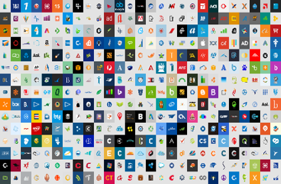

Azure AD
ADFS
Conditions
Controls
MSA
40TB
Google ID
Employee & Partner Users and Roles
Allow/block
access
Microsoft Cloud
Android
Session Risk
iOS
Trusted & Compliant Devices
Machine learning
3
MacOS
Limited
access
Microsoft Cloud App Security
Windows
Windows Defender ATP
Require
MFA
Real time Evaluation
Engine
Cloud SaaS apps
Force
password
reset
Geo-location
Physical & Virtual Location
******
Corporate Network
Policies
Effective policy
Client apps & Auth Method
Block legacy authentication
Browser apps
Client apps
On-premises & web apps

Slide 29

6.5 trillion correlated signals per day
Shared threat data from partners, researchers, and law enforcement worldwide
Microsoft Intelligent Security Graph
OneDrive
930M threats detected on devices every month
Outlook
400B emails analyzed
1.2B devices scanned each month
200+ global cloud consumer and commercial services
Botnet data from Microsoft Digital Crimes Unit
Windows
Enterprise security for 90% of Fortune 500
Azure
Microsoft accounts
18B+ Bing web pages scanned
Bing
450B monthly authentications
1.1B+ Azure user accounts
Xbox Live

Slide 30

Azure Active Directory Identity Protection Service
Azure AD & Microsoft Account
Schroedinger's User
Credentials
Classifier
Microsoft Azure Active Directory
Seems
Good
Seems
Bad
Learner
Analysis
Deploy
10+ TB Logs
Relying parties
Self-reporting
Threat data
Behavior
Update
True Negative
True Positive
Analyze
Inputs & Outcomes
We were right!
False Negative
False Positive
We were wrong!

Slide 31
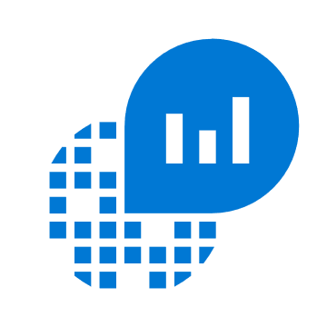
Azure AD in Azure Monitor
Full observability for your Azure AD Infrastructure
Audit
Logs
Sign-in
Logs
Common Store
Unified Monitoring
Analyze
Workflow Integrations
A common platform for all Azure AD logs
Rich Insights, advanced analytics and smart machine learning powered by Log Analytics
Rich ecosystem of popular issue management, SIEM, and ITSM tools
Status: Public Preview

Slide 32
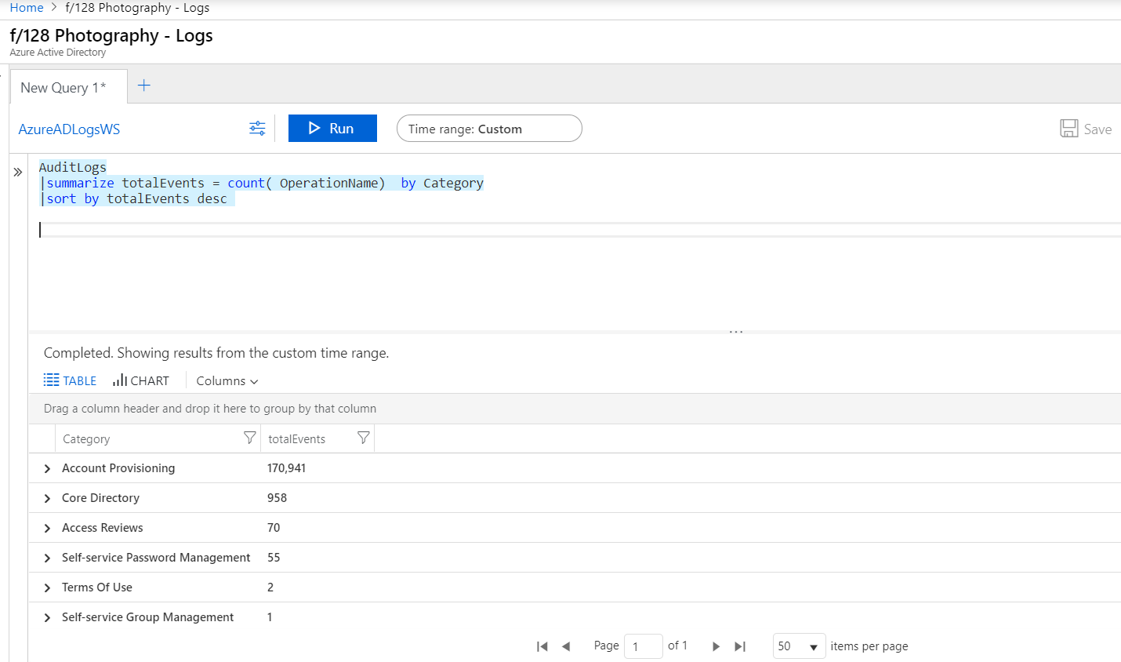
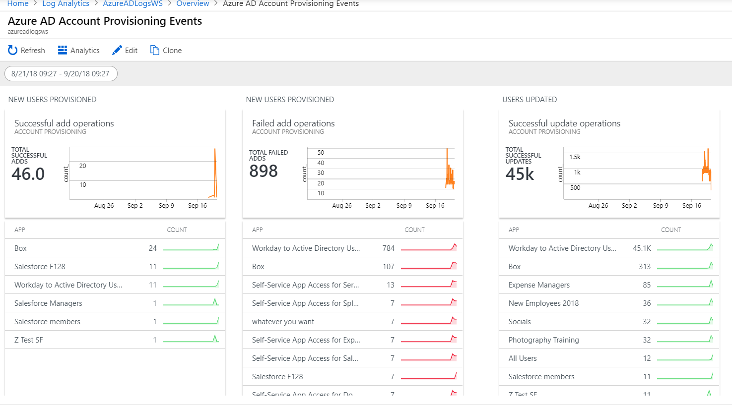
Advanced Queries with Log Analytics
Log Analytics advanced query experience now in Azure Portal
Central Analytics Platform across Monitoring, Management, Security
Run ADEQL queries for investigations, statistics, and root cause + trend analyses
Utilize ML algorithms for clustering and anomaly detection
Setup custom alerts and actions
Dashboard views

Slide 33
Lifecycle management
Notes:
EMS Overview
© 2014 Microsoft Corporation. All rights reserved. Microsoft, Windows, Surface and other product names are or may be registered trademarks and/or trademarks in the U.S. and/or other countries. The information herein is for informational purposes only and represents the current view of Microsoft Corporation as of the date of this presentation. Because Microsoft must respond to changing market conditions, it should not be interpreted to be a commitment on the part of Microsoft, and Microsoft cannot guarantee the accuracy of any information provided after the date of this presentation. MICROSOFT MAKES NO WARRANTIES, EXPRESS, IMPLIED OR STATUTORY, AS TO THE INFORMATION IN THIS PRESENTATION.
4/28/2019
33

Slide 34


Identity Governance is key in a modern world
The right controls that ensure secure productivity
Governance
Security
Who has / should have access to which resources?
What are they doing with that access?
Are there effective organizational controls for managing access?
Can auditors verify that the controls are working?
The right people have the right access to resources
Productivity
Timely access to the right resources

Slide 35
Identity lifecycle management is the foundation
Governance
Enabling secure productivity
Identity Lifecycle Management
The right controls that ensure secure productivity
Security
How quickly can a person have access to the resources they need, when they join my organization?
How should the access change over time based on changes to the person’s status?
How do I automate this process?
How do I know if the process is working?
The right people have the right access to resources
Productivity
Timely access to the right resources

Slide 36
Identity lifecycle management
Employees and contingent staff
Onboard from on-premises AD or cloud HR (e.g., Workday)
Drive productivity and agility with automation & delegation capabilities
Enable users to manage their own credentials and use single identity to access both cloud & on-premises applications
Business partners and suppliers
Bring in users via B2B invites and API
Partner users can self-request and be auto-provisioned
Access reviews remove unnecessary guest accounts
No access
1st job role
Identity
2nd job role

Slide 37

Azure AD
Strong authentication

Slide 38
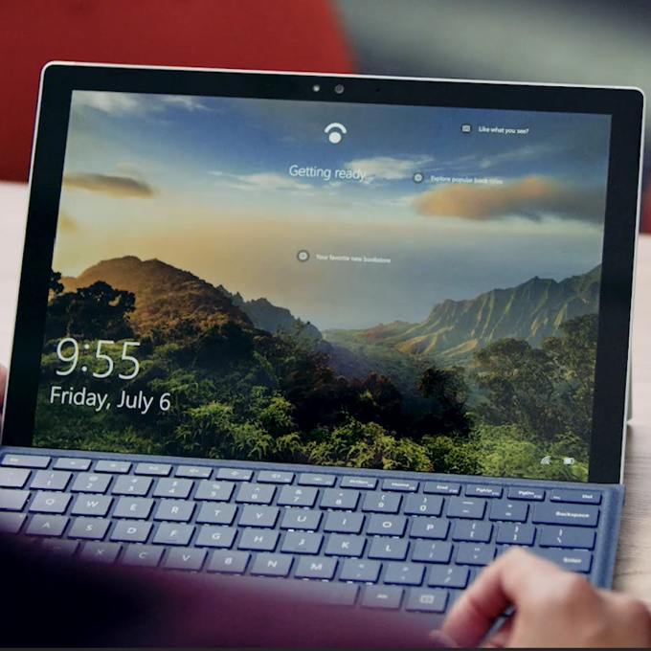
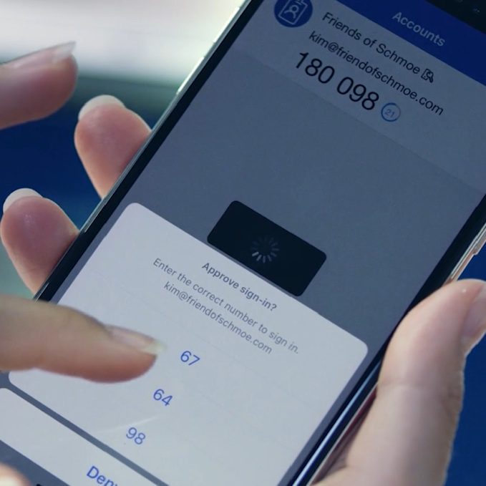

Getting to a world without passwords
High security, convenient methods of strong authentication
Windows Hello
Microsoft Authenticator
FIDO2 Security Keys

Slide 39
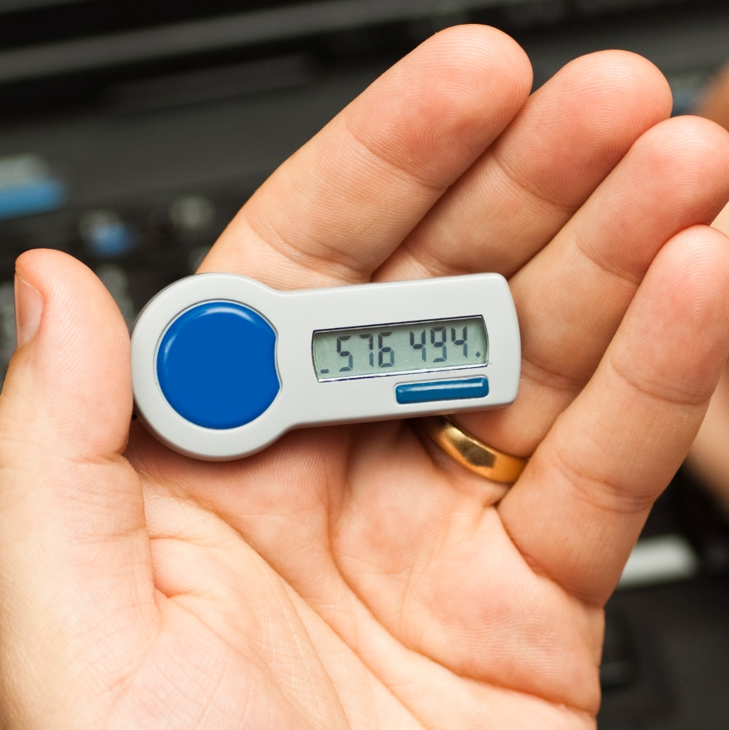

Secure Authentication
Password-less authentication
Multi-factor authentication
Password protection

Slide 40

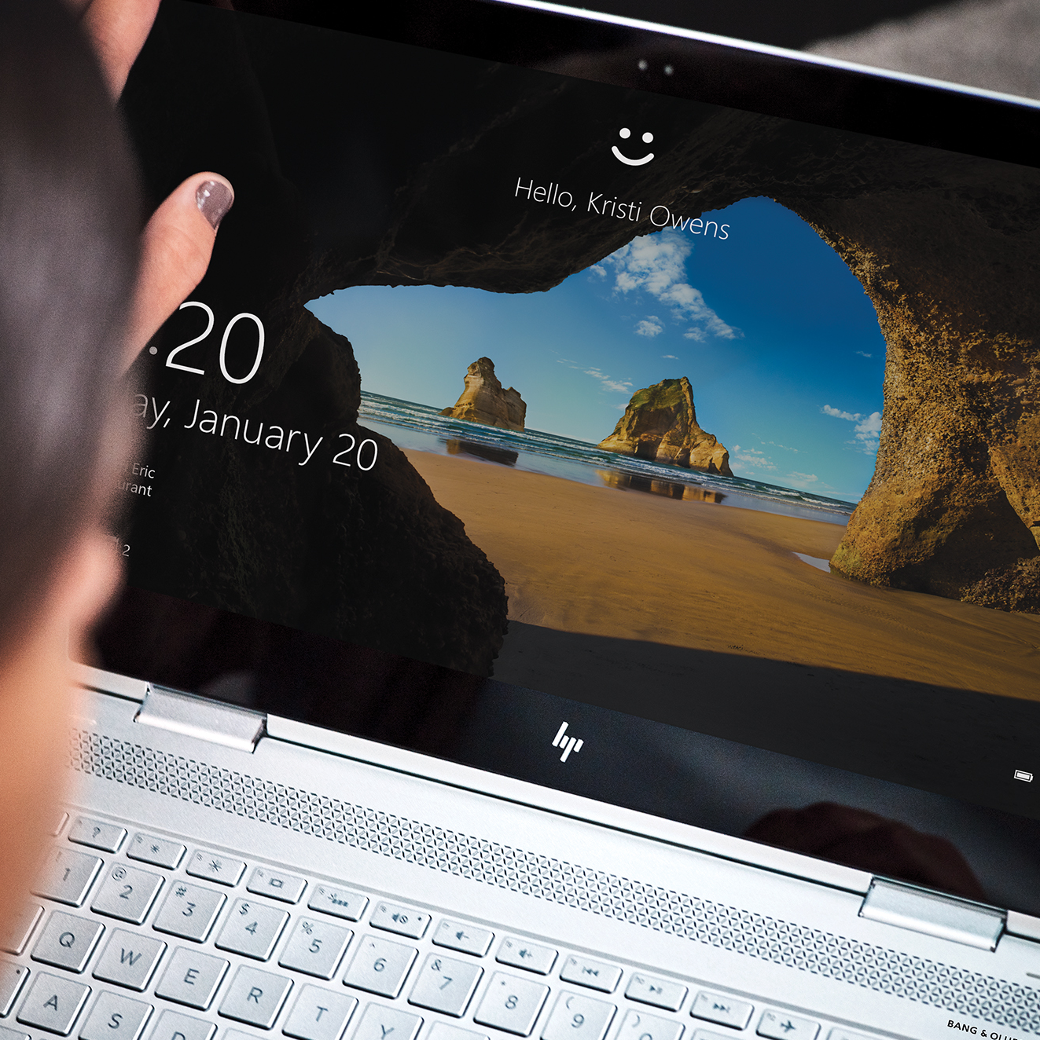
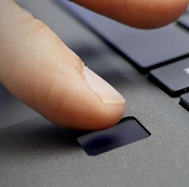
Go password-less with Windows 10 Hello
Enterprise-grade security
User-friendly experience
Password-less authentication
47M
6.5K
350%
active Windows Hello users
enterprises have deployed Windows Hello for Business
growth in biometric capable computers

Slide 41
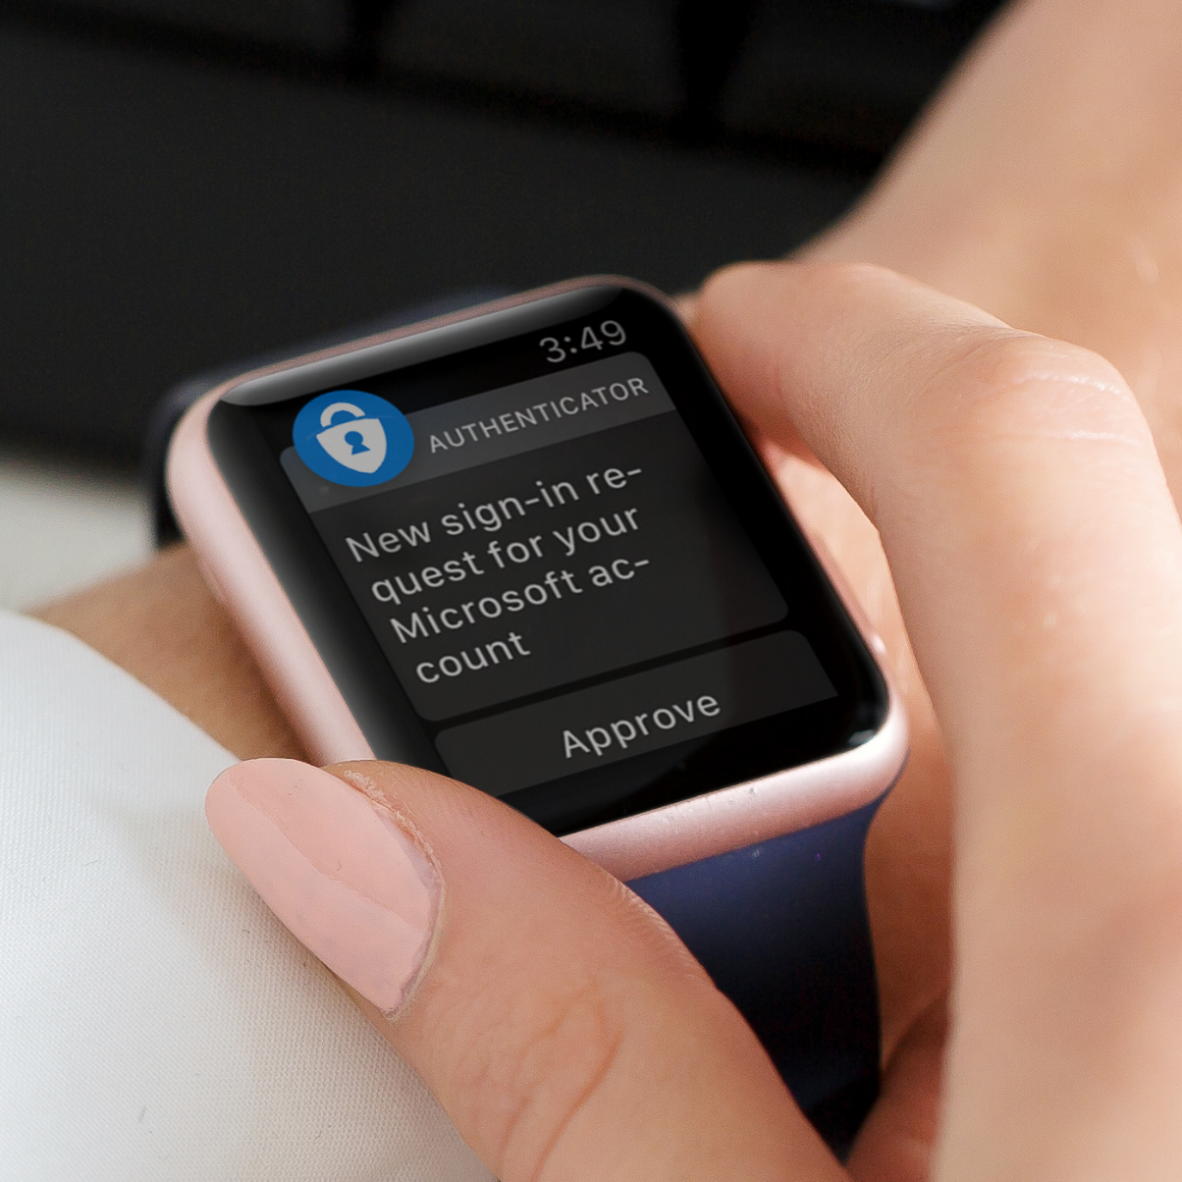
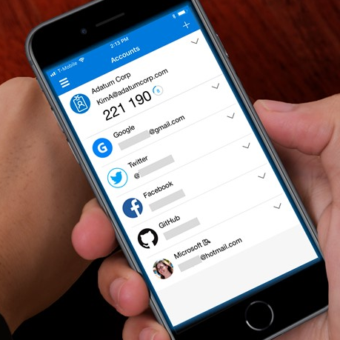
Go password-less with Microsoft Authenticator
OATH passcodes for 3rd party accounts
Password-less authentication
User-friendly experience
5M+
20M+
active users
downloads

Slide 42
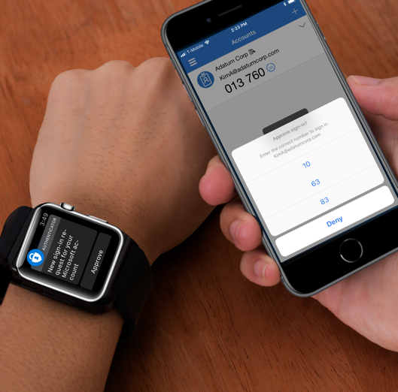
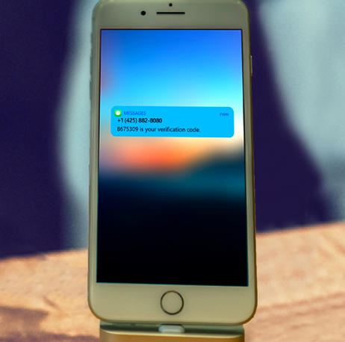

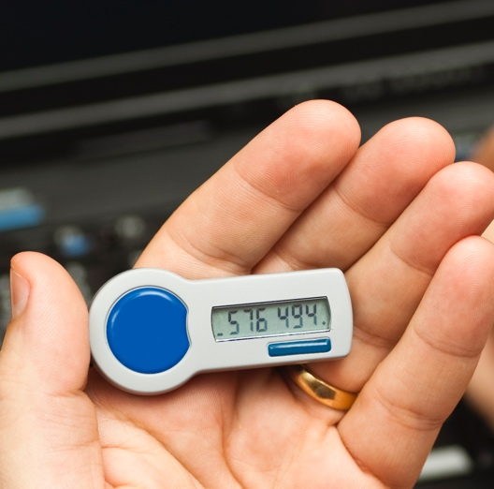
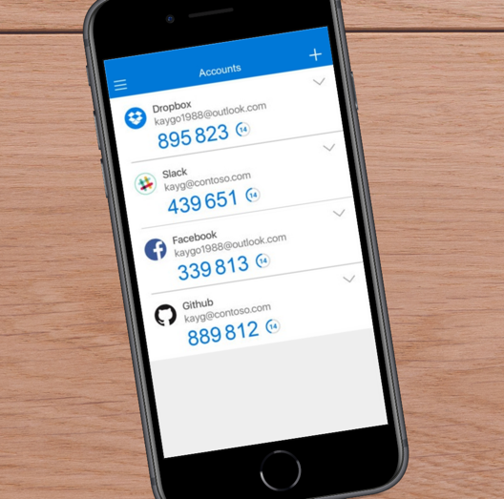
Multi-factor authentication
Prevents 99.9% of identity attacks
Push-approval
SMS
Voice call
OATH Token
OATH codes

Slide 43
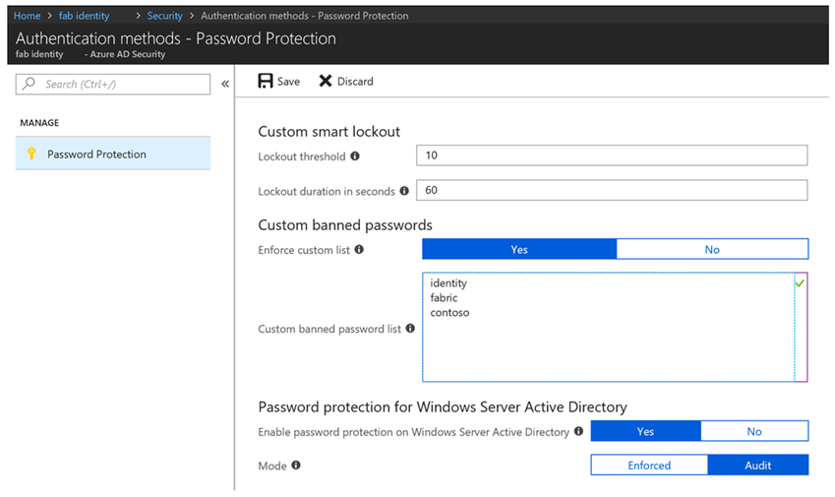
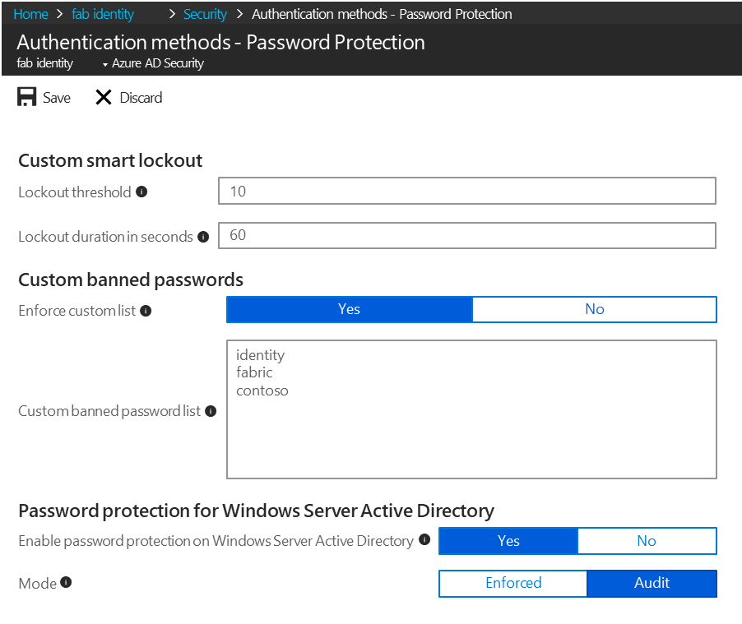
Azure AD Password Protection
Cloud intelligence to ensure strong passwords
Dynamic banning of passwords based on known bad patterns and those you define.
Smart Lockout to thwart bad actors trying to guess passwords.
Built for hybrid environments.
Unified admin experience for on-premises and cloud.

Slide 44
Azure AD
Seamless collaboration
Easy collaboration
BYOI Identity
Completely customizable user experiences

Slide 45

Easier to share via B2B
Same gesture to invite a guest as to share with an internal user
Guests only have to manage one credential

Slide 46
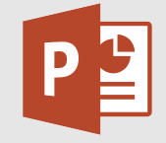
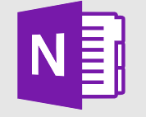
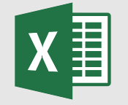
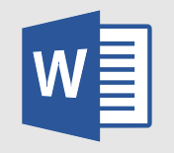
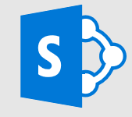
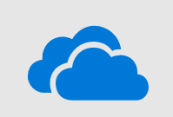

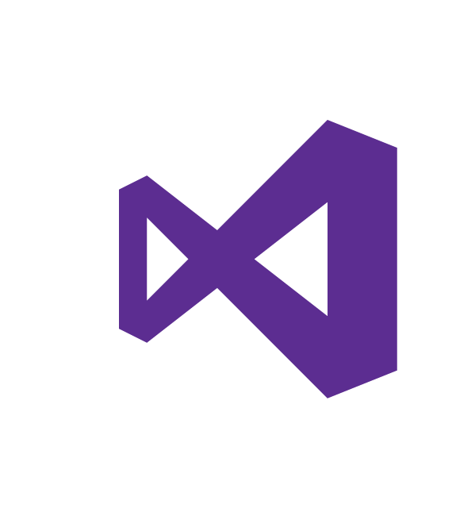

Share and collaborate with guests in Microsoft products
Teams
Office365 Groups
SharePoint/Office client
Power BI
Visual Studio
…and more

Slide 47
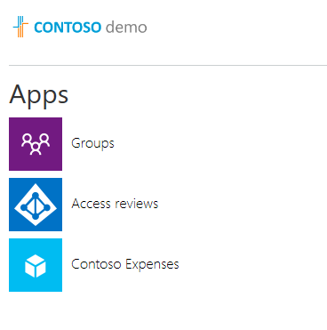
Works seamlessly with custom apps and resources
Guests are just users in Azure AD
All Azure AD managed Apps and resources automatically support guests
Access to custom LOB apps and 3rd party apps can be granted to guests

Slide 48
Bring Your Own Identity (BYOI)
Enabling work with any partner on the planet
Azure AD
IT managed
No IT
Azure AD
One-time passcodes
Direct federation
One-time passcodes
Microsoft accounts
Google federation
One-time passcodes
Generally available
Public Preview
Coming soon
Partner Type | Description | Current | Roadmap
Type 1: PARTNERS WITH Azure AD | Partner has an Azure AD and the user has an account | Supported
 | Partner has an Azure AD but the user doesn’t have an Azure AD account | Not supported | Private Preview: Email-based Sign-in with OTP
Type 2: PARTNERS WITHOUT Azure AD | Partner has an IT department and an Identity solution, but no Azure AD (ex. OnPrem, AWS, Google@Work) | Supported through creation of JIT Azure AD accounts (aka “viral accounts”) | Private Preview: Email-based Sign-in with OTP Private Preview: Direct Federation
Type 3: PARTNERS WITH NO IT | Partner has no IT department, uses social ID (ex. Gmail, MSA, comcast.net, etc.) | Supported through creation of JIT MSA and Google accounts (in Preview) | Private Preview: Email-based Sign-in with OTP Public Preview: Google Federation

Slide 49
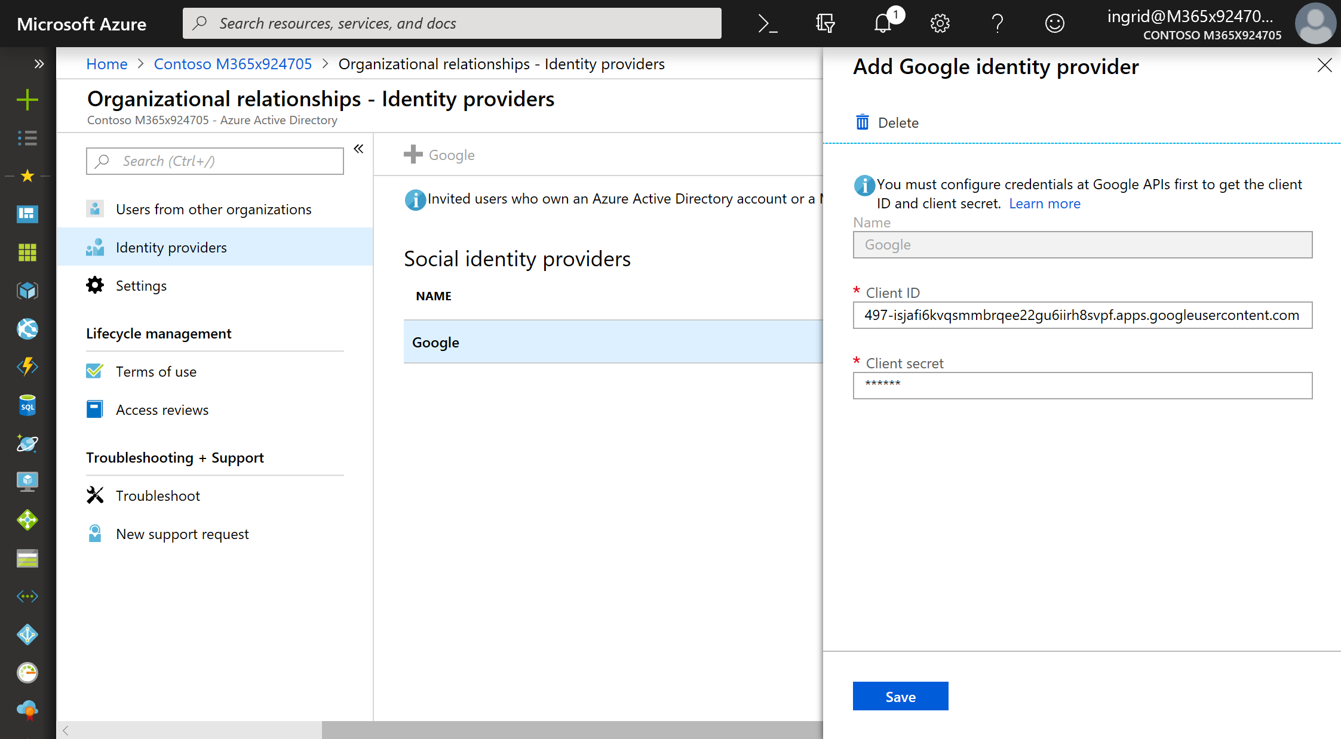
BYOI - Google federation
Enables users with Gmail accounts to use those credentials for B2B

Slide 50
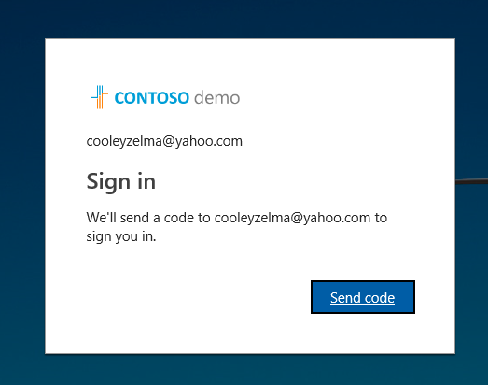
BYOI - One time passcodes
Supports authentication of any user with any non-federated email address
Appear just like any other guest in Azure AD and can have all the same control mechanisms

Slide 51
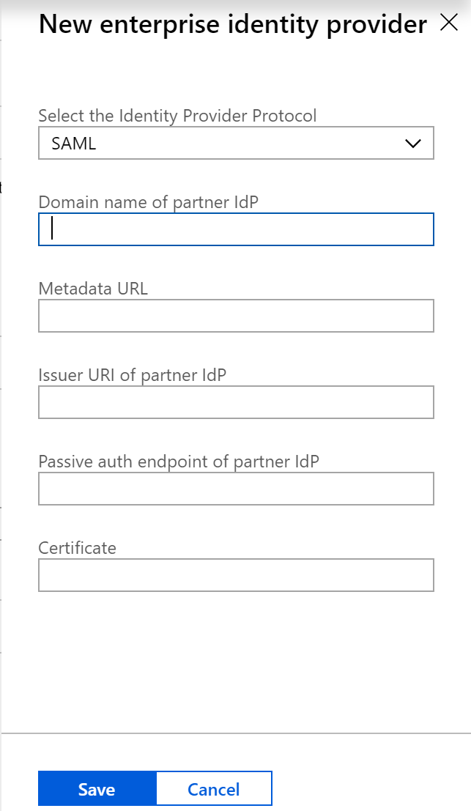
BYOI - Direct federation
Enables admins to enable B2B authentication from any Identity Provider that supports the SAML or WS-Fed protocols
Can be a solution for hybrid environments

Slide 52

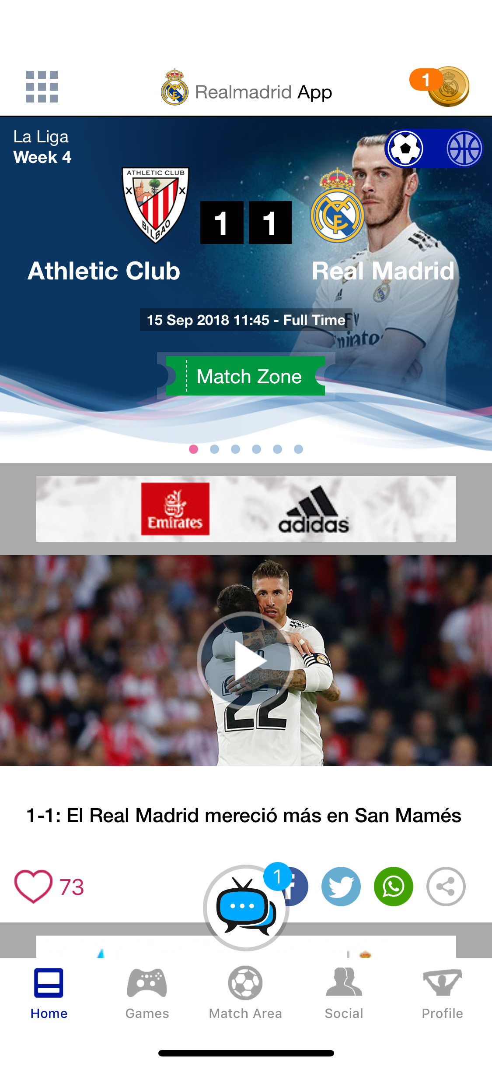
Azure AD B2C

Slide 53
Opportunities for identity modernization
Hybrid identity
Lifecycle management
Partner collaboration
Notes:
EMS Overview
© 2014 Microsoft Corporation. All rights reserved. Microsoft, Windows, Surface and other product names are or may be registered trademarks and/or trademarks in the U.S. and/or other countries. The information herein is for informational purposes only and represents the current view of Microsoft Corporation as of the date of this presentation. Because Microsoft must respond to changing market conditions, it should not be interpreted to be a commitment on the part of Microsoft, and Microsoft cannot guarantee the accuracy of any information provided after the date of this presentation. MICROSOFT MAKES NO WARRANTIES, EXPRESS, IMPLIED OR STATUTORY, AS TO THE INFORMATION IN THIS PRESENTATION.
4/28/2019
53

Slide 54
Unlock more capabilities with your modernized identity infrastructure
Secure authentication
Conditional access
Identity protection
Consumer identities
Developer resources

Slide 55
Azure AD: Summary
World-class security
Strong authentication
Seamless collaboration

Slide 56
Azure AD
Identity is the new control plane

Slide 57

Thank you
For more information microsoft.com/identity
@rbrayb

